Slide 1



Job Recommendation System
Team:
U18CO009 Keyur Tarsariya
U18CO010 Ganesh Jadhav
U18CO018 Shubham Shekhaliya
U18CO039 Jigar Nainuji
Guide :
Sankita J Patel
Assistant Professor at NIT-Surat

Slide 2



Main Challanges
Accurately use the data to extract the skills
Use this skills to find and recommend the top-n matching items

Slide 3
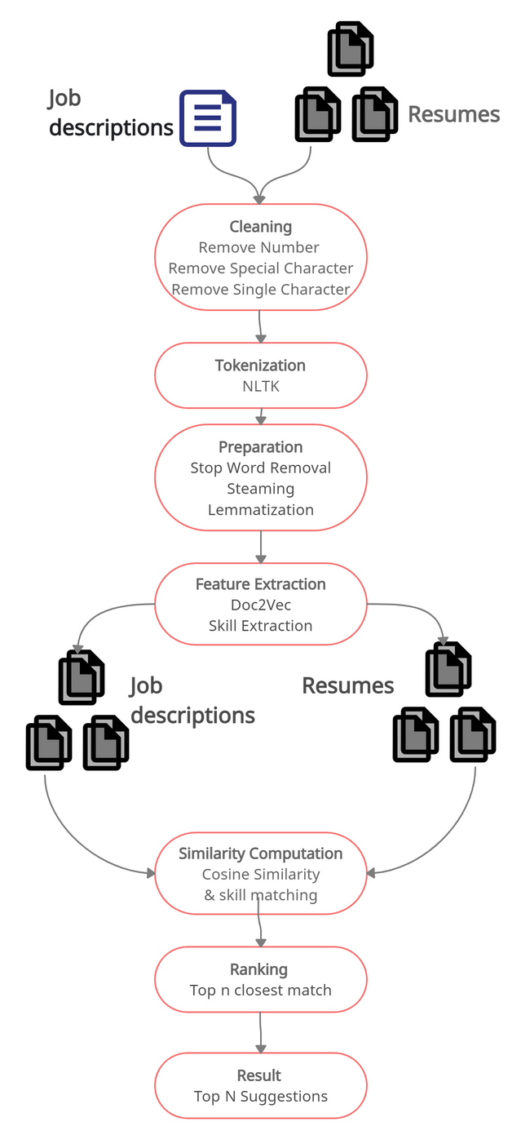


Proposed Methodology

Slide 4
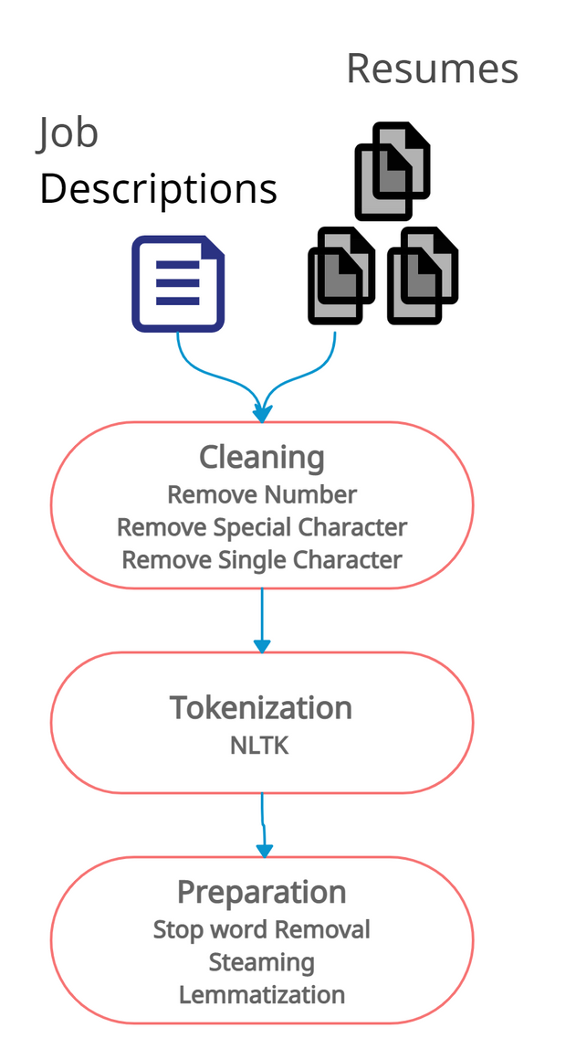
Data Preparation
Transforming into lower case
Individual words are extracted and tokenized with the help of white spaces and line breaks
stemming and lemmatization are performed to convert the given word into a root word
Elimination of white spaces, newline and punctuation marks.
Removal of stop-words such as ”a”, ”an”, ”the” etc.
Removal of non-ASCII keywords
PITCH DECK V 1.0

Slide 5
Feature Extraction
Resume
Tools : tools, IDE, editors
Projects : projects, publication, certificate
Work experience : work experience ,
past history, job roles
Job Description
Required skills: required skills, Technical skills,
soft skills
Projects : plus point, brownie point, good to have,
advantageous
PITCH DECK V 1.0

Slide 6


Implicit Skills
Implicit Skills are the skills which are defind in resume and job description
Explicit Skills
Explicit Skills are the skills which are derived by comparing one job description to other job description

Slide 7
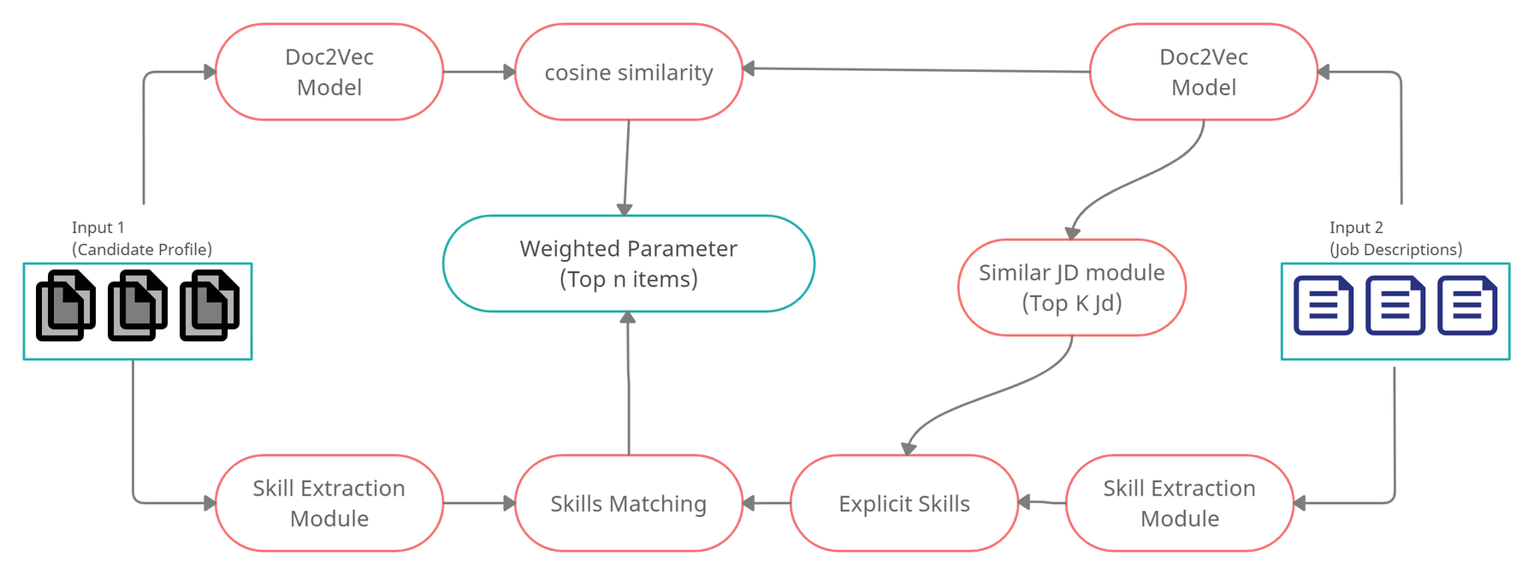
Flow diagram Of Proposed System

Slide 8
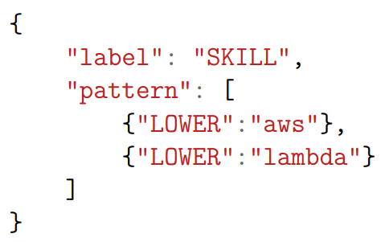
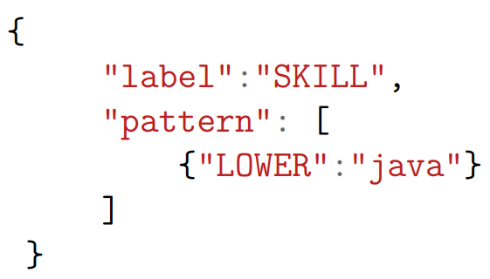
Skills Extraction
Entity Patterns
2000+ rules are defined
(1) Phrase patterns
(2) Token patterns

Slide 9
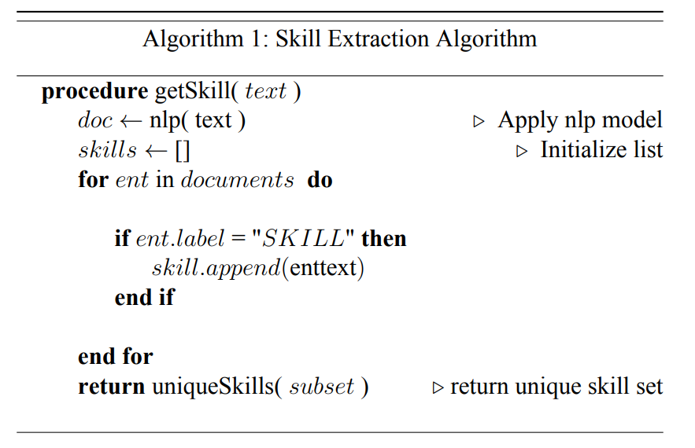
Skills Extraction
Example:
skills = ["java", "data structure", "machine leaning"]

Slide 10
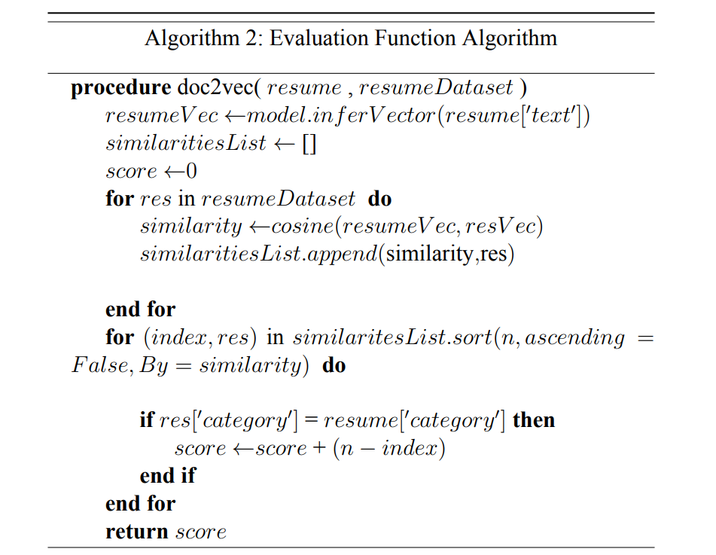
Tuning of Hyperparameters of Doc2Vec model
To choose Optimal hyperparameters of resumes and JD
Hyperparameters: Vector_size, Window, Epochs

Slide 11
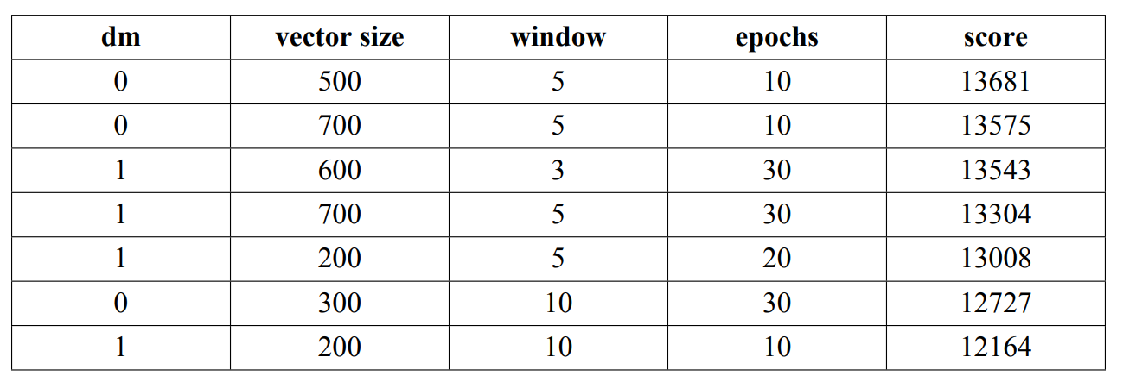
Hyperparameters tuning for the resume dataset
Total 108 combinations of the parameters are used
optimal Hyperparameters for resume are dm = 0(Distributed Memory Model), vector size = 500, window = 5, epochs=10

Slide 12
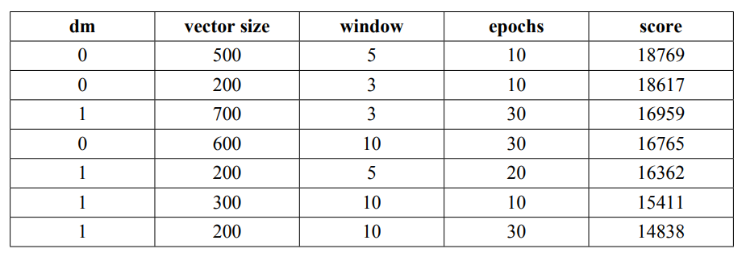
Hyperparameters tuning for the job description dataset
Best optimal Hyperparameters for Job description are dm = 0, vector size = 500, window = 5, epochs=10

Slide 13
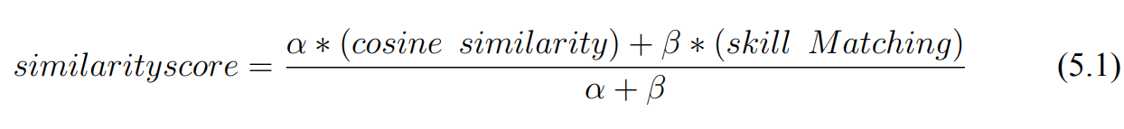
Finding Similarities
Similarity techniques
Cosine similarity
Skill matching
Weighted similarity score
Where, α = weighted constant for cosine similarity
β = weighted constant for skill matching
Used Evaluation Function Algorithm to find score

Slide 14
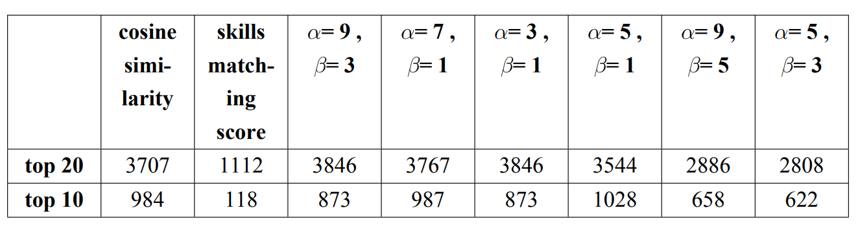
Recommending the Resumes to the Job Description
Gives better result on the weighted value of α = 3 and β = 1

Slide 15
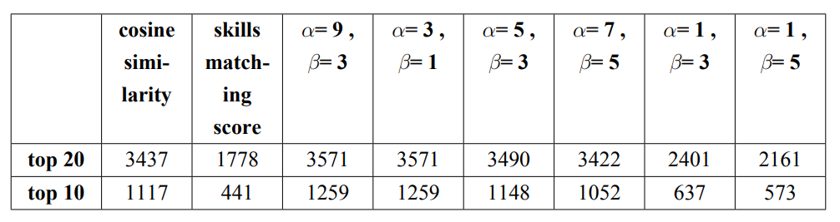
Recommending the Job descriptions to the resume
Gives better result on the weighted value of
α = 3 and β = 1 or α = 9 and β = 3

Slide 16
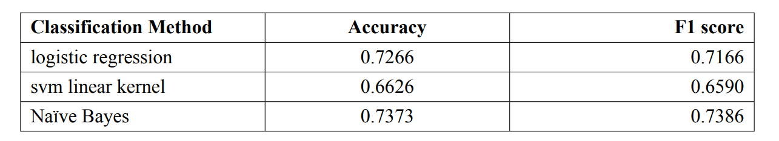
Classification Result Analysis
Optimal Hyperparameters for classification are
vector size = 325, window = 15, epochs = 25
Comparison of result

Slide 17
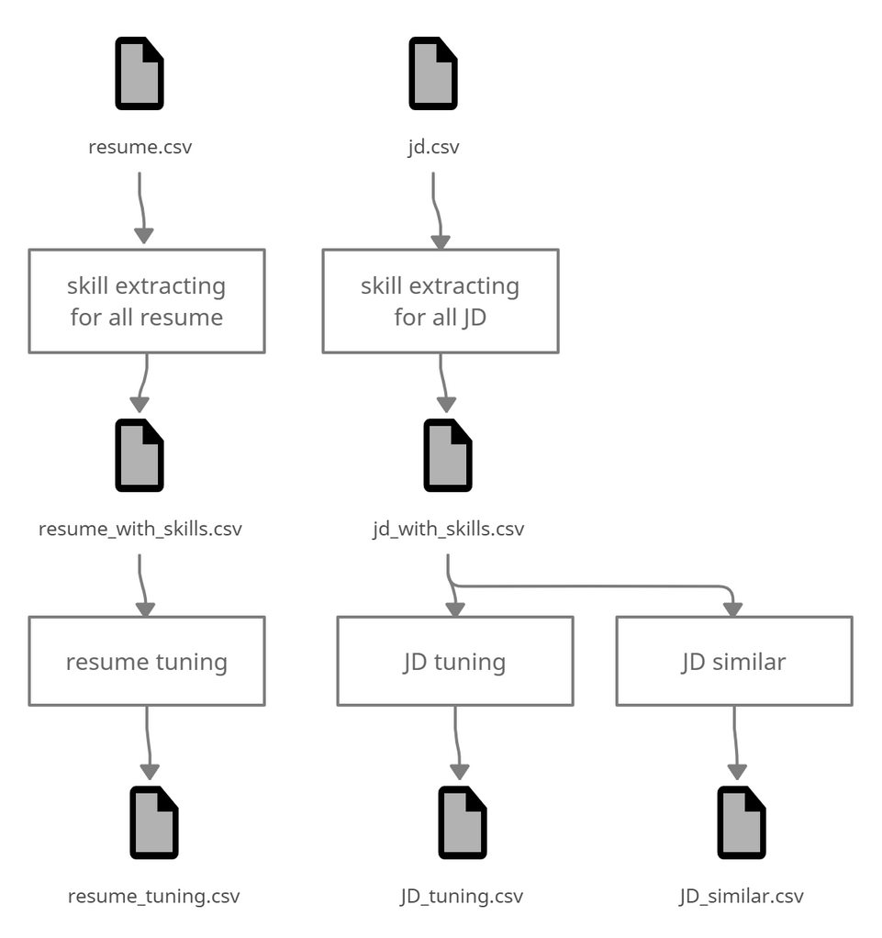
Flow of Recommendation Model

Slide 18
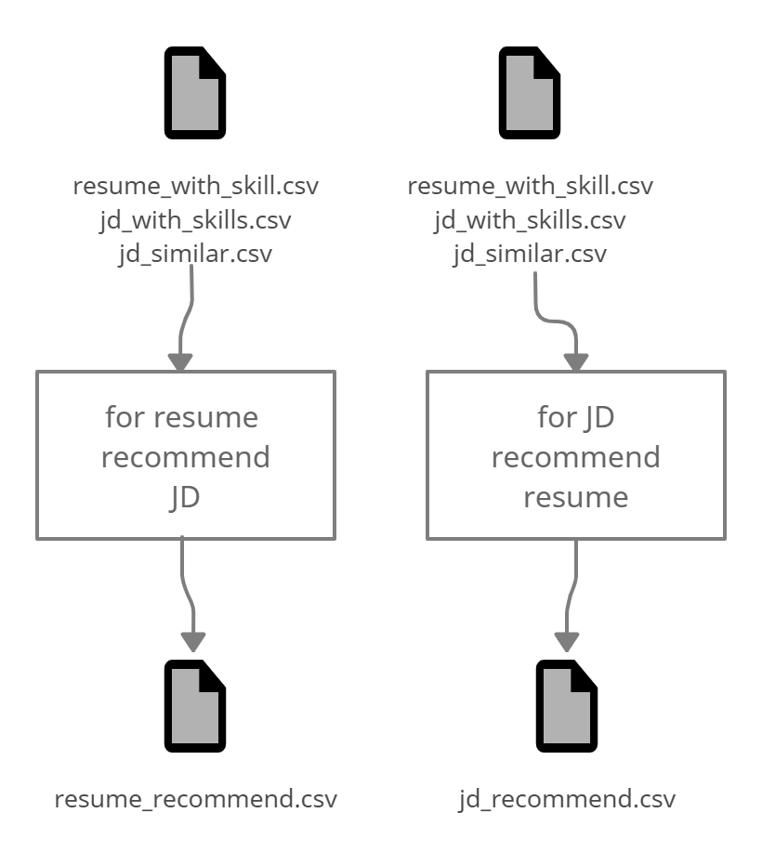
Flow of Recommendation Model

Slide 19
Conclusion
Making automation of the resume matching process
Extracting Skills using nlp
Training Doc2Vec model
Skills Matching
Cosine Similarity
Similarity Score

Slide 20
Future works
Extended for all job types
Hadoop distributed files for better optimization
Skills dictionary can be made dynamic
System can be hosted on the cloud

Slide 21





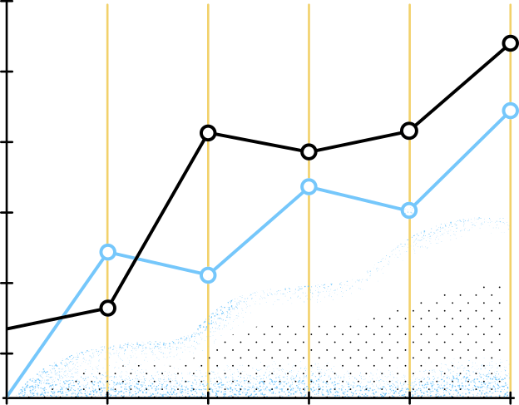


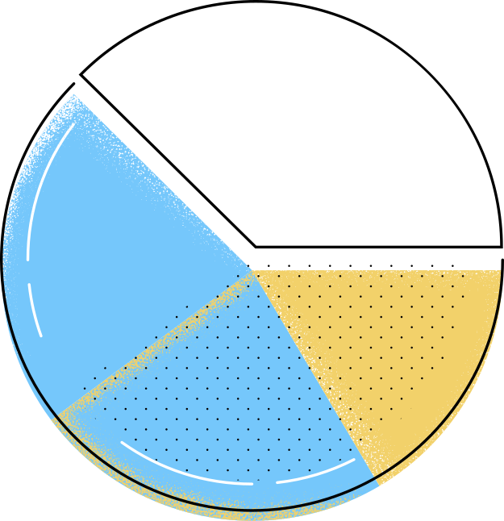





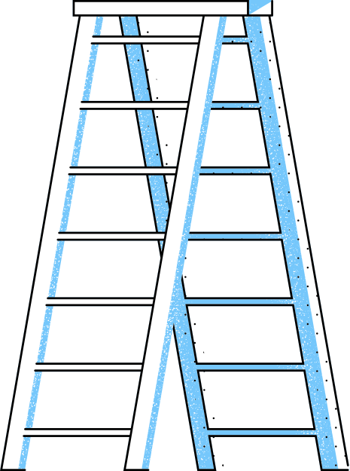

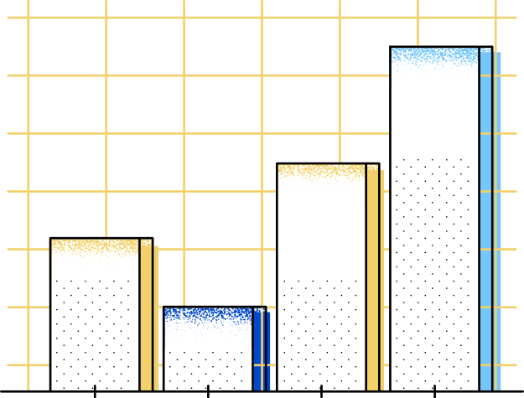
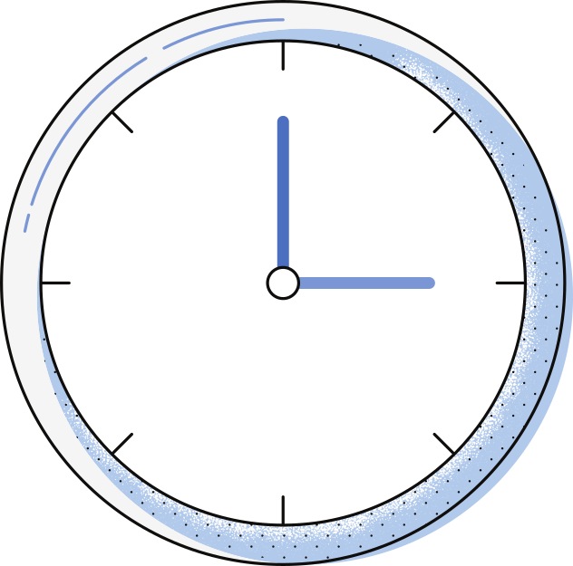


Thank You
A big Thanks to Dr Sankita J Patel for giving us valuable guidance

